Slide 1
URINARY RETENTION
Fadi Jehad Zaben RN MSN
IMET 2000, Rammallh

Slide 2
Outline:
Definition.
Etiology.
Pathophysiology.
Clinical Manifestations.
Diagnostic Evaluation.
Treatment.
Complications.
Nursing Care Plan.

Slide 3
Definition:
Urinary retention is the inability to empty the bladder completely during attempts to void.
Chronic urine retention often leads to overflow incontinence (from the pressure of the retained urine in the bladder).
Most common in men.
Increasing incidence with increasing age.

Slide 4
Continue……
Residual urine is urine that remains in the bladder after voiding.
In a healthy adult younger than age 60, complete bladder emptying should occur with each voiding.
In adults older than age 60, the residual urine is 50 to 100 mL because of the decreased contractility of the detrusor muscle.

Slide 5
Pathophysiology:
Urinary retention may result from:
Diabetes.
Prostatic enlargement.
Urethral pathology (infection, tumor, calculus), and trauma (pelvic injuries).
Pregnancy.
Neurologic disorders such as cerebrovascular accident, spinal cord injury, multiple sclerosis, or Parkinson’s disease.
Medications cause urinary retention, either by inhibiting bladder contractility or by increasing bladder outlet resistance.

Slide 6
Continue…….
Medications that cause retention by inhibiting bladder contractility include:
Anticholinergic agents (atropine sulfate, dicyclomine hydrochloride ).
Antispasmodic agents (oxybutynin chloride, and opioid suppositories).
Tricyclic antidepressant medications (imipramine [Tofranil], doxepin [Sinequan]).
Medications that cause urine retention by increasing bladder outlet resistance include:
Alpha-adrenergic agents (ephedrine sulfate, pseudoephedrine).
Beta-adrenergic blockers (propranolol).
Estrogens.

Slide 7
Continue……
Urinary retention can occur postoperatively in any patient, particularly if the surgery affected the perineal or anal regions and resulted in reflex spasm of the sphincters.
General anesthesia reduces bladder muscle innervation and suppresses the urge to void, impeding bladder emptying.

Slide 8
Signs and Symptom:
The patient may verbalize an awareness of bladder fullness and a sensation of incomplete bladder emptying.
Signs and symptoms of urinary tract infection, such as hematuria and dysuria.
Complain of pain or discomfort in the lower abdomen.
Voiding small amounts of urine frequently.
Dribbling urine.
Restlessness and agitation.
Dullness percussion over the bladder.

Slide 9
Diagnosis:
History of Complaints and Physical Examination.
Urine Sample (Signs of infection).
Voiding diary to provide a written record of the amount of urine voided and the frequency of voiding.
Bladder Scan (Post void residual (PVR) urine ultrasound test); asked the patient to urinate, and then will do the bladder scan to determine the post-void residual “less than 100 ml considered”.

Slide 10
continue…...
Blood investigations:
CBC: (increasing WBC my indicated urinary infections).
Urea and creatinin (increasing indicted to kidney problems).
PSA: may unreliable.

Slide 11
Medical Treatment:
PHARMACOLOGIC THERAPY:
Parasympathomimetic medications, such as bethanechol (Urecholine), may help to increase the contraction of the detrusor muscle.
SURGICAL MANAGEMENT:
In some cases, surgery may be carried out to correct bladder neck contractures or vesicoureteral reflux or to perform some type of urinary diversion procedure.
CATHETERIZATION.

Slide 12
CATHETERIZATION:
Catheters are inserted directly into the bladder, the ureter, or the renal pelvis.
Catheters vary in size, shape, length, material, and configuration.
The type of catheter used depends on its purpose.
A patient should be catheterized only if necessary because catheterization commonly leads to urinary tract infection.
Urinary catheters have been associated with other complications, such as bladder spasms, urethral strictures, and pressure necrosis.

Slide 13
Continue……..
Catheterization is performed to achieve the following:
Relieve urinary tract obstruction.
Assist with postoperative drainage in urologic and other surgeries.
Provide a means to monitor accurate urine output in critically ill patients.
Promote urinary drainage in patients with neurogenic bladder dysfunction or urine retention.
Prevent urinary leakage.

Slide 14
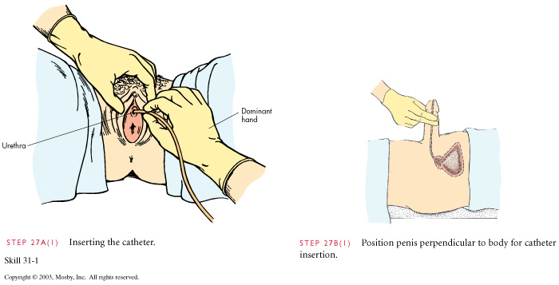

Slide 15
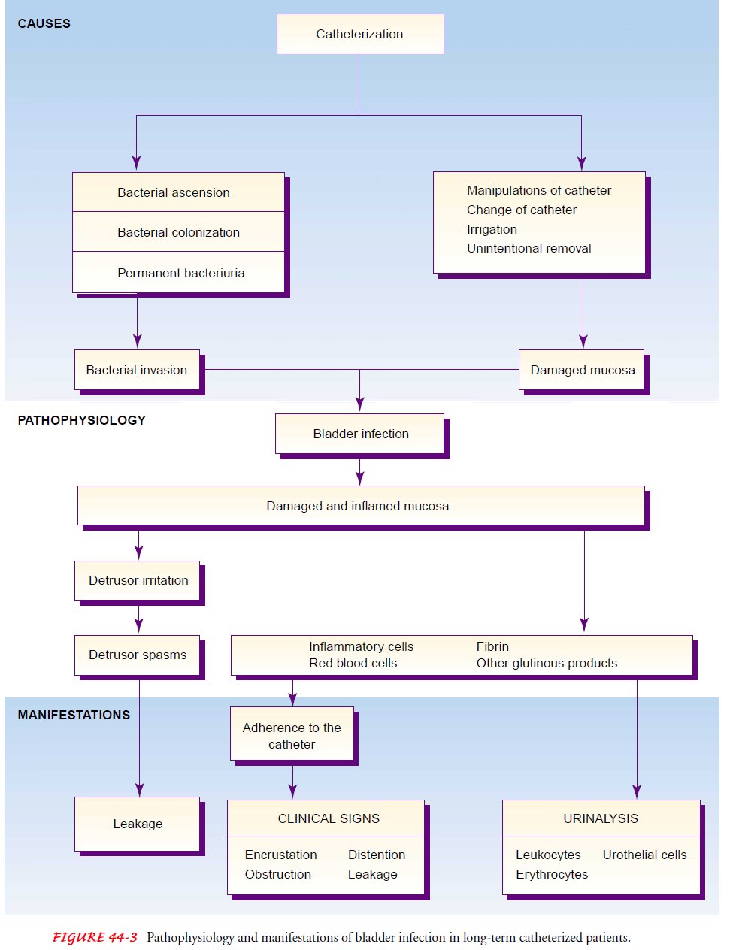

Slide 16
Guidelines for Preventing Infection in the Catheterized Patient:
Use scrupulous aseptic technique during insertion of the catheter (sterile, closed urinary drainage system).
To prevent contamination of the closed system, never disconnect the tubing. The drainage bag must never touch the floor. The bag and collecting tubing are changed if contamination occurs, if urine flow becomes obstructed, or if tubing junctions start to leak at the connections.
If the collection bag must be raised above the level of the patient’s bladder, clamp the drainage tube. This prevents backflow of contaminated urine into the patient’s bladder from the bag.
Ensure a free flow of urine to prevent infection. Improper drainage occurs when the tubing is kinked or twisted, allowing pools of urine to collect in the tubing loops.
To reduce the risk of bacterial proliferation, empty the collection bag at least every 8 hours through the drainage spout—more frequently if there is a large volume of urine.
Avoid contamination of the drainage spout.

Slide 17
Continue…….
Never irrigate the catheter routinely. If the patient is prone to obstruction from clots or large amounts of sediment, use a three way system with continuous irrigation.
Never disconnect the tubing to obtain urine samples, to irrigate the catheter, or to ambulate or transport the patient.
Never leave the catheter in place longer than is necessary.
Avoid routine catheter changes. The catheter is changed only to correct problems such as leakage, blockage, or encrustations.
Avoid unnecessary handling or manipulation of the catheter by the patient or staff.
Carry out hand hygiene before and after handling the catheter, tubing, or drainage bag.
Wash the perineal area with soap and water at least twice a day; avoid a to-and-fro motion of the catheter. Dry the area well, but avoid applying powder because it may irritate the perineum.
Monitor the patient’s voiding when the catheter is removed. The patient must void within 8 hours; if unable to void, the patient may require catheterization with a straight catheter.
Obtain a urine specimen for culture at the first sign of infection.

Slide 18
Complications:
Chronic infection.
Calculi.
Pyelonephritis.
Sepsis.
The kidney may also eventually deteriorate if large volumes of urine are retained, causing backward pressure on the upper urinary tract.
Skin breakdown if the urine leak to perineal.

Slide 19

Nursing Management:
Management strategies are instituted to:
Prevent over distention of the bladder.
Treat infection or correct obstruction.
The nurse should explain why normal voiding is not occurring and should monitor urine output closely.
The nurse should provide reassurance about the temporary nature of retention and successful management strategies.

Slide 20
PROMOTING NORMAL URINARY ELIMINATION:
Encourage voiding include providing privacy, ensuring an environment and a position conducive to voiding.
Assisting the patient with the use of the bathroom or commode, rather than a bedpan, to provide a more natural setting for voiding.
The male patient may stand beside the bed while using the urinal.
Applying warmth to relax the sphincters.
Giving the patient hot tea, and offering encouragement and reassurance.

Slide 21
Continue……
Simple trigger techniques, such as turning on the water faucet while the patient is trying to void.
Other examples of trigger techniques are stroking the abdomen or inner thighs, tapping above the pubic area, and dipping the patient’s hands in warm water.
After surgery, the prescribed analgesic should be administered because pain in the incisional area can make voiding difficult.

Slide 22
PROMOTING URINARY ELIMINATION:
When the patient cannot void, catheterization is used to prevent over distention of the bladder.
In the case of prostatic obstruction, attempts at catheterization may not be successful, requiring insertion of a suprapubic catheter.
After urinary drainage is restored, bladder retraining is initiated for the patient who cannot void spontaneously.

Slide 23
Conclusion:
Acute retention is a common but easily treated condition.
there are variety of common causes; most commonly are BPH and UTI’s.
It is important to do fully investigate the cause and treat accordingly to prevent permanent damage to urinary tract and prevent recurrence.
The nursing care is the most interventions role to decrease the UTI’s.

Slide 24
The end

