Slide 1
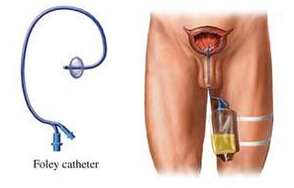
CATHETERIZATION AND CATHETER CARE
Fadi Jehad Zaben RN MSN
IMET 2000, Ramallah

Slide 2
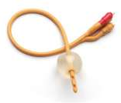
Overview:
Catheterization and Catheter Care.
Appropriate drainage system with support.
Bag position.
Advising patients.
Plan for removal.
Catheter problems.

Slide 3
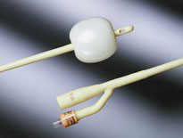
Catheterisation and Catheter Care:
A urinary catheter is an appliance which is inserted into the bladder in order to drain the urine.
It consists of a hollow tube with two independent channels inside it.
  For the urine to drain via a number of openings (‘eyes’) at the tip of the catheter.
  To inflate the balloon with sterile water to help retain it in the bladder.

Slide 4
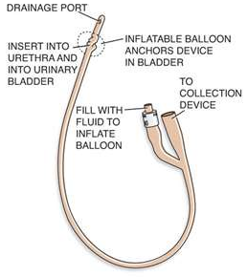
Catheter History:
Since early times, ‘catheters’ of one description or another have been used for the same purpose. The earliest known catheters are understood to have been used by the Chinese and were made from dried reeds and palm leaves.
Frederick Foley in 1935 was the first to design a catheter that had an integral balloon which served to retain it in the bladder
(Roe 1992).

Slide 5
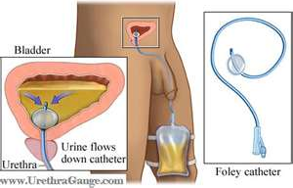
Indications for Catheterisation:
Urine drainage post operatively.
Accurate measurement.
Urinary retention.
Neurological dysfunction (disease/spinal injury).
Outlet obstruction if unfit for surgical repair.
Managing incontinence (only if all other methods of management have failed).

Slide 6
Prevalence:
  Up to 12.6% of hospital patients are catheterised.
  4.5% of people in the community.
  20-30% of hospitalised patients develop bacteruria.
  2-6% of these develop Urinary Tract Infection “Of those with an infection 1-4% develop bacteraemia and of those, 13-30% die”.

Slide 7
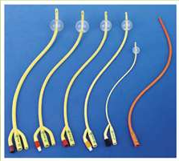
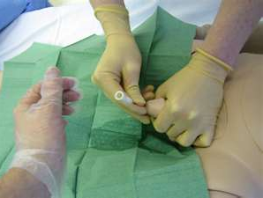
Good Catheter Care:
Correct choice of catheter.
Aseptic insertion.
Appropriate drainage system with support.
Bag position.
Correct advice to patients, i.e. hygiene, emptying, fluid intake.
Plan for removal/regular changes.
Deal with catheter problems.

Slide 8
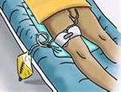
Choosing the Right Catheter:
  Ideal catheter:
    Soft: for comfort.
    Sufficiently firm: for easy insertion and maintaining lumen patency.
    Largest possible lumen size: for the smallest possible external diameter.
    ‘Elastic recoil’, so that balloon can be deflated to its original size.
    Causes minimal tissue reaction.
    Inhibits colonisation by microorganisms.
    Resists encrustation by mineral deposits.

Slide 9
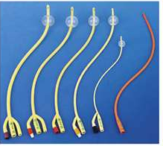
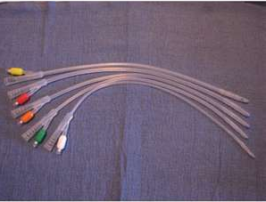
For each patient, you should consider the following:
  Material.
  Length of catheter.
  Balloon.
  Catheter size.

Slide 10
Catheter Materials
1. PVC or PLASTIC:
  Short term (approx 14 days).
  Prone to encrustation.
  Uncomfortable to sit on.
  Cheap.
  Thin walled – largest lumen.
  Water absorption low.
  Used as ISC Catheters.

Slide 11
2. LATEX:
  Short term (approx. 14 days).
  Soft & flexible.
  Prone to rapid encrustation.
  High surface friction, discomfort and irritation.
  May cause urethral tissue inflammation.
  Absorption of water and body fluids may lead to increase in overall diameter and reduction in lumen size
  Does the patient have a latex allergy?

Slide 12
Continue……. Latex…..
2.1 TEFLON COATED LATEX:
  Medium term (up to 4 weeks).
  Coating makes surface smoother.
  Easier to insert.
  Still prone to encrustation.
  Less absorption of water.
  Less urethral irritation.
2.2 SILICONE ELASTOMER-COATED LATEX:
  Long term (up to 12 weeks).
  Easy to insert.
  Less encrustation and urethral irritation.
2.3 HYDROGEL COATED LATEX:
  Long term (up to 12 weeks).
  High compatibility with human tissue.
  Slippery surface – reduction of trauma.

Slide 13
2.4 100% SILICONE:
  Long term (up to 12 weeks).
  Thin walled – larger lumen.
  Resistant to encrustation.
  Less tissue irritation.
  Slow diffusion of water out of balloon can occur.
  Problems with ‘elastic recoil’.
  Product of choice.
2.5 HYDROGEL COATED LATEX:
  Long term (up to 12 weeks).
  High compatibility with human tissue.
  Slippery surface; reduction of trauma.
  2.6 HYDROMEL COATED SILICONE:
  Long term (up to 12 weeks).
  Advantages of being hydrogel coated without risks of latex allergy.

Slide 14
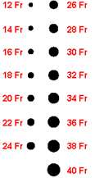
Catheter Selection: Urethral
LENGTH:
  Standard (Male) length 43cm
  Female length 18cm
BALLOON SIZE:
10ml sterile water only (30ml, only in specialist practice)
SIZE:
  (1CH is 1/3mm external diameter)
  Smallest possible is best - Urine clear 12-14ch
            Urine cloudy 14ch
            Blood clots 16ch+

Slide 15
LARGE CATHETERS CAUSE:
  Increased bladder irritability.
  Spasms.
  Bypassing – urethral folds do not clamp tight around catheter.
  Ulceration of bladder neck.
  Blockage of para-urethral glands (which produce the mucus lining of the urethra – against ascending infection).

Slide 16
Urethral v Supra-pubic
Supra-pubic:
  Less pain.
  Does not damage urethral tissue.
  More comfortable (especially chairbound patients).
  Allow sexual activity.
  Reduced infection rates.
  Easy ‘Trial Without Catheter’ (TWOC) by clamping.
  Patients/ Carers can change own catheter.

Slide 17
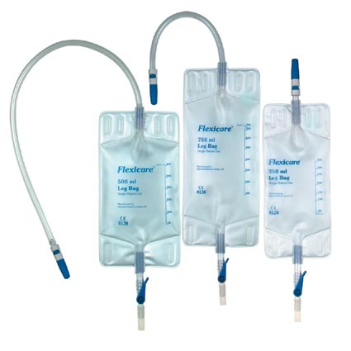
Catheter Drainage: Leg Bags
Appropriate drainage system with support
Many options exist:
  350ml/500ml/750ml.
  Short / long tube.
  Choice of tap for ease of opening.
  Additional felt backing for comfort.
  ‘Chambered’ - prevents ‘sloshing’ sound.
  Flexible sleeve below tap allows ‘in line’ connection to bed bag.

Slide 18
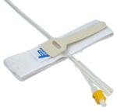
Support
Various methods exist to anchor the catheter to the leg.
These prevent traction being exerted on the bladder by the balloon due to any ‘dragging’ effect ie full, or poorly supported leg bag,
With leg straps secured by velcro, you need to ensure these are not pulled too tight.
With sleeves, you need to ensure legs are measured correctly

Slide 19
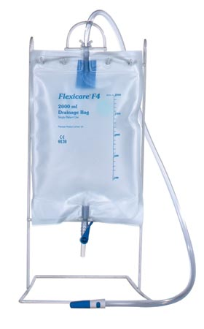
Catheter Drainage: Bed Bags
  2 litres capacity.
  Reusable bags available with tap (for use in patient’s own home).
  Single use for use in ‘care settings’.
  Varying tap designs.
  Need to use the correct stand to keep tap from making contact with floor.

Slide 20
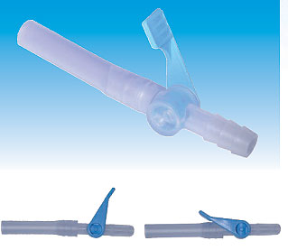
Catheter Valves:
Catheter valves are fitted to the end of the catheter and when closed, allow the bladder to fill in the usual way.
When the patient experiences the sensation of bladder ‘fullness’ the tap can be opened and the urine drained.

Slide 21
Catheter Valves:
Prerequisites for using a valve:
  Manual dexterity to operate valve
  Ability to understand concept of intermittent drainage
  Adequate bladder capacity
  Needs to have sensation of bladder ‘fullness’
Inappropriate for:
  Uncontrolled ‘detrusor overactivity’
  Renal impairment
  Ureteric reflux
  Medical opinion should be sought to ensure none of the above apply.

Slide 22
Advice to Patients/Carers:
  Inform patients of need to wash hands thoroughly, before and after emptying drainage bags and carrying out catheter care.
  Importance of meatal and catheter cleansing.
  Details of how to secure catheter and support drainage bags.
  To empty leg bags when half full to prevent ‘dragging’ effect of too full a bag.
  Care of reusable night bags.
  To maintain good fluid intake, at least 2 litres per day.
  Ensure patients/carers are aware of signs and symptoms of urinary tract infection and how to access help when difficulties occur. The opening of the ‘closed system’ between catheter and bag is one of the major sources for infection entering the system. Ensure leg bags & catheters are only changed according to manufacturers recommendations
  Bed bags must be located on a stand to ensure there is no contact with the tap and the floor.
  How to obtain further supplies.

Slide 23
Plan for Removal:
Follow manufacturers’ recommendations.
All patient documentation should indicate either when a catheter is due for removal, or when a routine change is due.
A ‘catheter diary’ for each patient is a useful tool, recording full details of each change, especially useful for patients who experience problems with ‘blockage’.

Slide 24
Catheter Problems:
Kinked tubing.
Constipation – pressure on drainage lumen.
Occlusion of drainage eyes – negative pressure.
Debris – related to fluid intake.
Haematuria – blood clots.
Encrustation.
Infection.

Slide 25
1. Kinked Tubing:
Kinked tubing can cause bypassing.
To avoid:
  Use most appropriate length of tubing for each individual patient: short or long tube?
  Always the first thing to check with any catheter problem, e.g. if blocking or bypassing.
  Ensure that the tubing has not become kinked by pressure from patient’s sitting position or clothing.

Slide 26
2. Constipation:
Constipation can result in a full rectum, which can cause pressure on the drainage lumen of the catheter and stop it draining.
Ensure patients maintain a good fluid intake and where appropriate offer dietary advice.
Consider use of laxatives if other measures fail.

Slide 27
3. Occlusion of Drainage Eyes:
If drainage bags are positioned 30cm or more below the level of the bladder, this can create a negative pressure at the catheter tip and bladder mucosa can get ‘sucked into’ the ‘eyes’ of the catheter and thus stop it draining.
Easily rectified by lifting and securing the catheter above this level.

Slide 28
4. Debris: Blockage
Encouraging the patient to maintain a good fluid intake helps to alleviate this problem.

Slide 29
5. Haematuria:
Expected and often dealt with for patients in hospital on urology wards after surgery.
Not expected for those patients with long term urinary catheters, need to inform a senior health professional or doctor as soon as possible.

Slide 30
6. Encrustation
Over 50% of patients with urinary catheters experience problems with encrustation. A partial or complete blockage of the drainage lumen by mineral deposits of ‘struvite’ or ‘calcium phosphates. Getliffe & Dolman (2003)
Management of this problem is either by changing the catheter before problems occur, by use of a ‘catheter diary’ or considering the use of ‘catheter irrigation’ solutions on a regular basis.

Slide 31
7. Infection
Signs & Symptoms of infection:
  Pyrexia
  Pyuria
  Dysuria
  Urine bypassing the catheter
  Cloudy coloration of the urine
  Foul smelling urine
  Confusion or falling (especially in the elderly)

Slide 32


