Slide 1
Central Venous Line (CVL)
AND
Central Venous Pressure (CVP)
Fadi Jehad Zaben RN MSN
IMET2000, Ramallah

Slide 2
Learning Outcomes:
Describe the sites of central venous catheterization.
Understand why central venous pressure monitoring is performed.
Demonstrate how to perform central venous pressure monitoring using a manometer and a transducer.
State normal parameters for CVP.

Slide 3
Introduction:
The central venous pressure reflects the right atrial pressure (RAP) and is similar to measuring the JVP clinically.
Central venous pressure measurement is often associated with intensive and critical care settings.
Circulating blood flows into the right atrium via the inferior and superior vena cava. The pressure in the right atrium is known as central venous pressure (CVP).
Critically ill unstable patients may need hourly measurements of CVP.

Slide 4
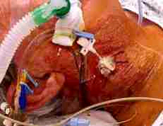
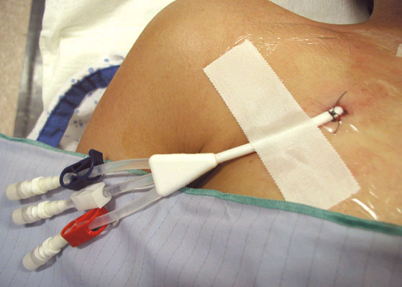
TYPES OF CENTRAL LINE:
SINGLE LUMEN
DOUBLE LUMEN
TRIPLE LUMEN
QUADRUPLE LUMEN
QUINTUPLE LUMEN

Slide 5
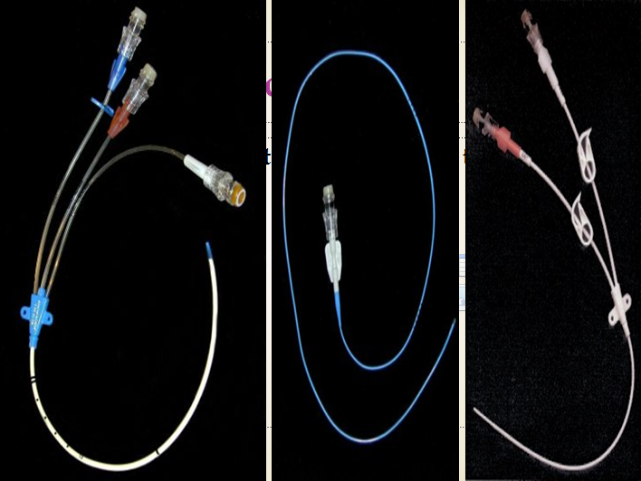
Single, Double, and Triple Lumen Central Lines

Slide 7
Indications Central Venus Line (CVL):
Need for IV access and failure of peripheral access
Peripheral access too painful or very difficult
Long term IV access anticipated
Infusion of drugs which may cause peripheral problems e.g. vasoconstriction, phlebitis
Hemodynamic monitoring
Volume resuscitation with large bore central lines
CVP measurement, Rt atrial pressure
To obtain frequent blood sample
To determine how much fluid is needed in 24 hr
Insertion of a pacing wire.

Slide 8
Relative Contraindications:
Bleeding disorders (platelet counts <50,000, bleeding is uncommon and easily managed).
Anticoagulation or thrombolytic therapy.
Combative patients.
Distorted local anatomy.
Cellulitis, burns, severe dermatitis at site.
Vasculitis.

Slide 9
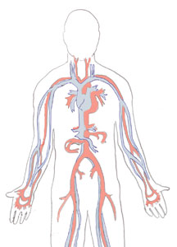
Sites for insertion of CVL:
Internal jugular.
Subclavian.
Femoral vein.
Brachial vein for long lines.

Slide 10
Factors Affecting the CVP:
Systemic vasodilatation and hypovolaemia, which leads to reduced venous return in the vena cava and reduced RAP
Right ventricular dysfunction and pulmonary hypertension leads to raise right atrial pressure, as does tricuspid and pulmonary stenosis.

Slide 11
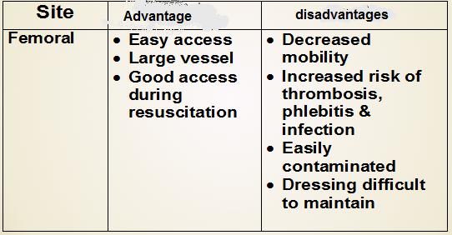
Advantages Versus Disadvantages Of Sites for insertion of CVL:

Slide 12
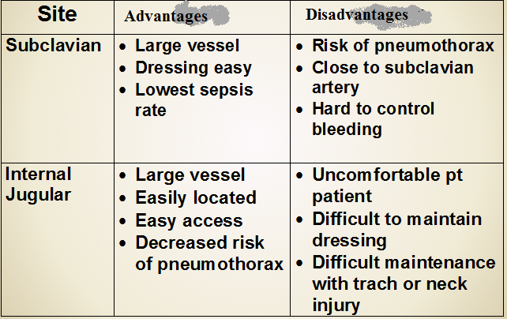
Continue……

Slide 13
Normal CVP Measurements:
The normal CVP is between 5 – 10 cm of H2O or (2-5) mmHg.
It increases 3 – 5 cm H2O when patient is being ventilated.

Slide 14
Increase of CVP:
CVP increased in the following conditions:
Over hydration.
Right-sided heart failure.
Cardiac tamponade.
Constrictive pericarditis.
Pulmonary hypertension.
Tricuspid stenosis and regurgitation.
Stroke volume is high.

Slide 15

CVP reading is High:

Slide 16
Decrease of CVP:
Hypovolemia.
Decreased venous return.
Excessive veno or vasodilation.
Shock.
If the measure is less than 5 cm water that mean that the circulating volume is decrease.

Slide 17
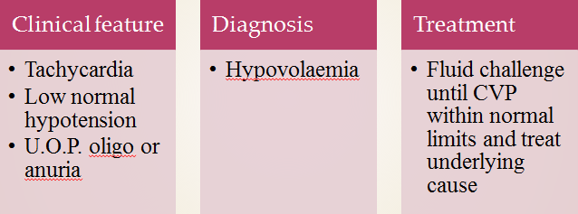
CVP reading is Low?

Slide 18
CVL Insertion:
Equipment.
Patient position.
Procedure.
After insertion.

Slide 19
Equipment:
Sterile gloves, gown, suture pack.
Iodine solution.
10 ml syringe, 2% lidocaine, 10 ml N.S.
Catheter special size.
H2O manometer.
Flush solution with complete CVP line.
Dressing set.

Slide 20
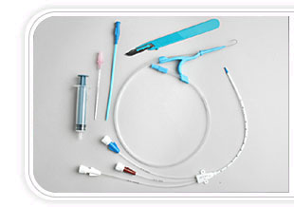
Catheterization Kits
Notes:
Go over kits and demonstrate procedure with students

Slide 21
Patient Position:
Patient is moved to the side of the bed so physician would not lean over.
The bed is high enough so physician would not have to stoop over.
Patient should be flat without a pillow, Trendelenburg position if patient is hypovolemic.
The head is turned away from the side of the procedure.
Wrist restraints if necessary.

Slide 22
Procedure:
Skin preparation:
Prepare before putting sterile gloves
Allow time for the sterilizing agent to dry
Drape:
Large enough and Handed sterilely by the assistant.
Hole in the area of placement.
Prepare the tray:
Prepare the equipment before starting.
Anesthesia:
Use local anesthesia with lidocaine.

Slide 23
Nursing Role After CVL Insertion:
Dispose all sharps.
Place an occlusive sterile dressing.
Flush lumens to maintain patency.
Obtain a chest x-ray (ask for order if physician doesn’t mention it).
Monitor site for bleeding.
Assess breath sounds.
Assess circulation.
Assess for hematoma.
Document insertion, site, dressing and flushing.

Slide 24
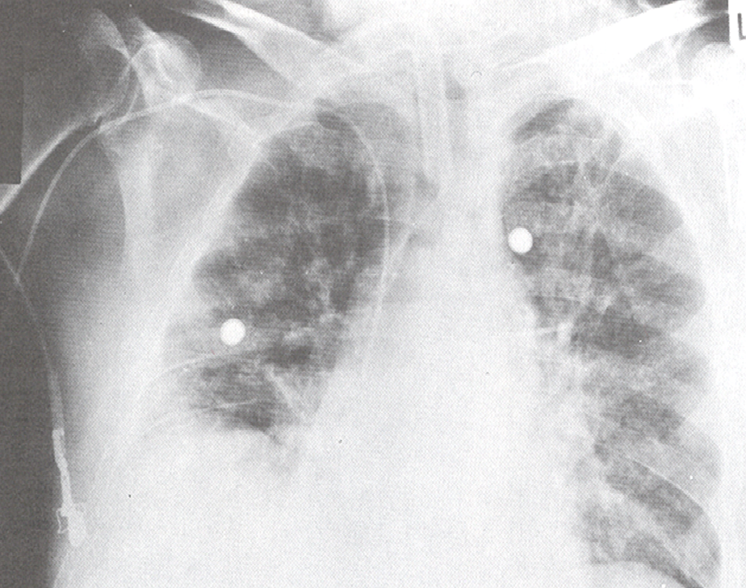
Chest X-ray and CVL

Slide 25
USING THE CENTRAL LINE:
Flush q shift, before and after use with NS.
Some places also require heparin flush.
Close clamps when not is use.
Dressing is usually changed every days.
Line can be used for blood drawing –withdraw and waste 10 cc, then withdraw blood for samples.
If port becomes clotted, do not use – sometimes ports can be opened up.

Slide 26
Immediately Complications of Insertion CVL:
Hemothorax.
Pneumothorax (most common).
Bleeding: More common in patients with coagulopathy“easily control femoral”.
Arterial puncture.
Vessel erosion: Large vessel perforation “Dialysis”.
Nerve Injury.
Dysrhythmias.
Catheter malplacement.
Embolus.
Cardiac tamponade.

Slide 27
Delayed Complications:
Dysrhythmias
Infection “Late, Femoral > IJ > subclavian”
Catheter malplacement.
Vessel erosion.
Embolus.
Cardiac tamponade.
Thrombosis.

Slide 28
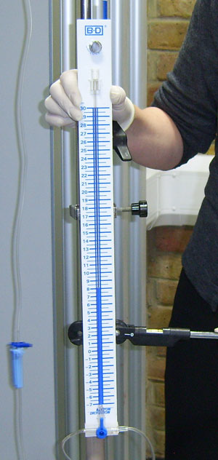
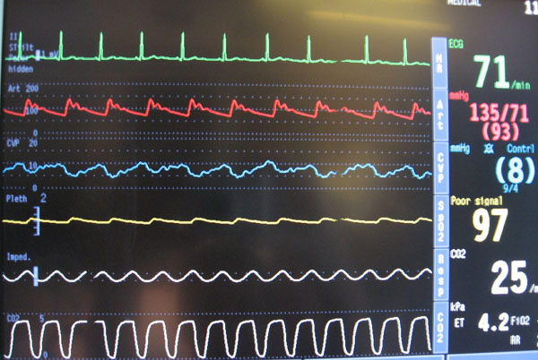
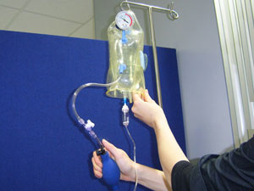
Measuring CVP:
There are two methods of CVP monitoring:
Manometer system: enables intermittent readings and is less accurate than the transducer system
Transducer system: enables continuous readings which are displayed on a monitor.

Slide 29
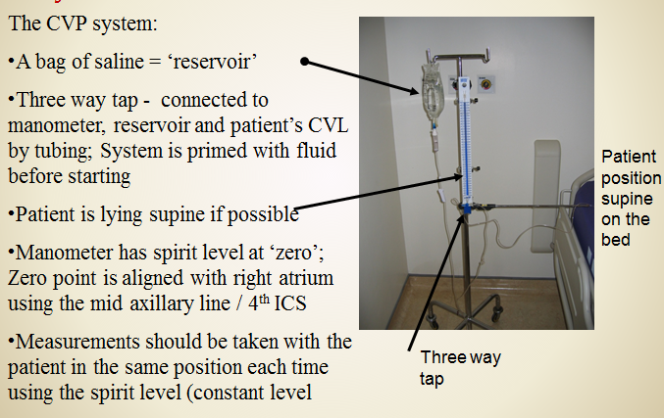
CVP System:

Slide 30
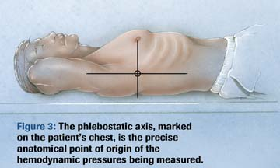
Phlebostatic Axis:
4th intercostal space, mid-axillary line
Level of the atria

Slide 31
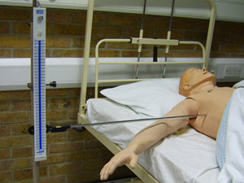
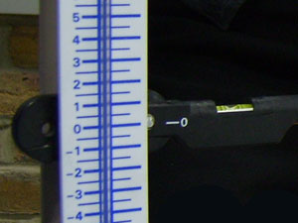
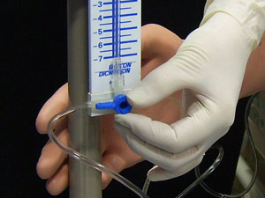
CVP Measurement:
Line up the manometer arm with
the phlebostaticaxis ensuring that
the bubble is between the two lines
of the spirit level.
2. Move the manometer scale up and
down to allow the bubble to be
aligned with zero on the scale.
This is referred to as 'zeroing the
manometer'.
3. Turn the three-way tap off to the
patient and open to the manometer.

Slide 32
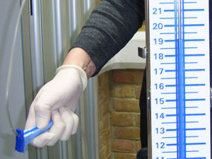

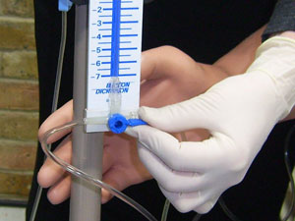
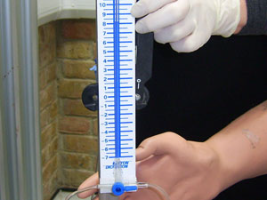
Continue…….
4. Open the IV fluid bag and slowly
fill the manometer to a level higher
than the expected CVP.
5. Turn off the flow from the fluid
bag and open the three-way tap
from the manometer to the patient.
6. The fluid level inside the
manometer should fall until gravity
equals the pressure in the central
veins.

Slide 33
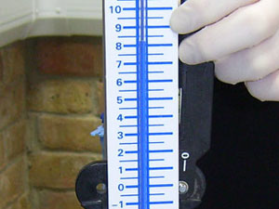
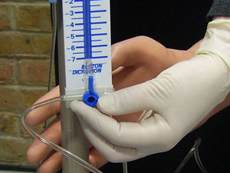
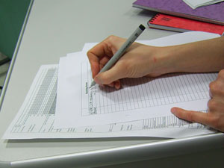
Continue…….
When the fluid stops falling the CVP measurement can be read. If the fluid moves with the patient's breathing, read the measurement from the lower number.
Turn the tap off to the manometer.
Document the measurement and report any changes or abnormalities.

Slide 34
Using a Transducer:
Explain the procedure to the
patient to gain informed consent.
The CVC will be attached to intravenous fluid within a pressure bag.
Ensure that the pressure bag is inflated up to 300mmHg.
Place the patient flat in a supine position if possible. Alternatively, measurements can be taken with the patient in a semi-recumbent position.
The position should remain the same for each measurement taken to ensure an accurate comparable result.

Slide 35
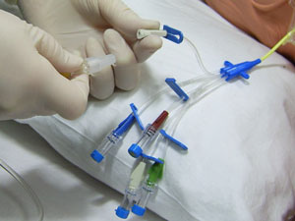
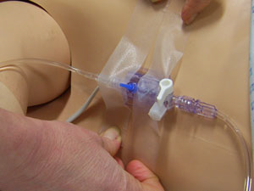
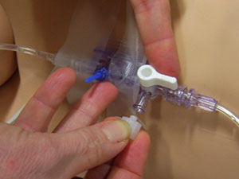
Continue…….
Catheters differ between manufacturers, however, the white or proximal lumen is suitable for measuring CVP.
Tape the transducer to the phlebostaticaxis or as near to the right atrium as possible.
Turn the tap off to the patient and open to the air by removing the cap from the three-way port opening the system to the atmosphere.

Slide 36
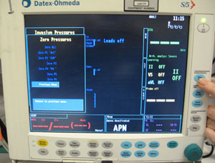
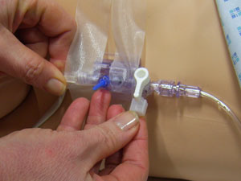
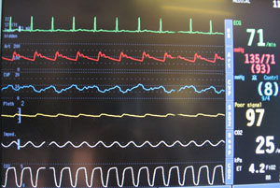
Continue…….
Press the zero button on the monitor and wait while calibration occurs.
When 'zeroed' is displayed on the monitor, replace the cap on the three-way tap and turn the tap on to the patient.
Observe the CVP trace on the monitor. The waveform undulates as the right atrium contracts and relaxes, emptying and filling with blood.
Document the measurement and report any changes or abnormalities.

Slide 37
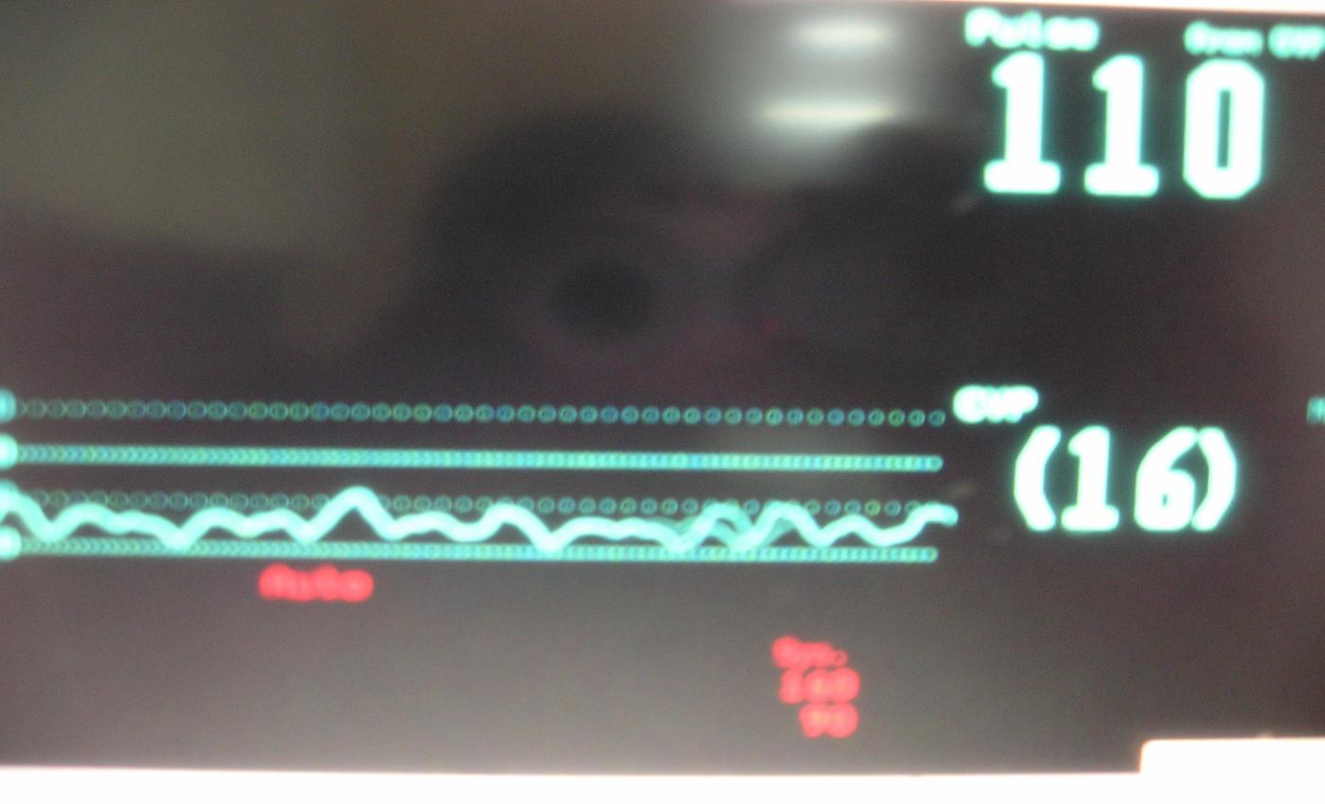
CENTRAL VENOUS PRESSURE

Slide 38
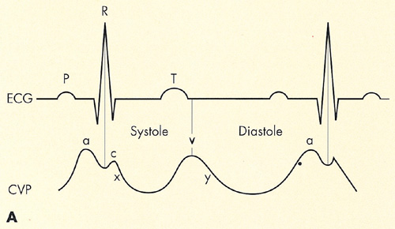
THE CVP WAVEFORM:
The CVP waveform reflects changes in right atrial pressure during the cardiac cycle
Notes:
A wave: right atrial contraction (P wave on the ECG)If the A wave is elevated the patient may have right ventricular failure or tricuspid stenosis.
C wave: tricuspid valve closure (follows QRS complex on the ECG).
V wave: pressure generated to the right atrium during ventricular contraction, despite the tricuspid valve being closed (latter part of the T wave on the ECG)

Slide 39
REMOVAL OF CENTRAL LINE:
This is an aseptic procedure.
The patient should be supine with head tilted down.
Ensure no drugs are attached and running via the central line.
Remove dressing.
Cut the stitches.
If there is resistant then call for assistance.
Apply digital pressure with gauze until bleeding stops.
Dress with gauze and clear dressing.

Slide 40

THE END

