Slide 1
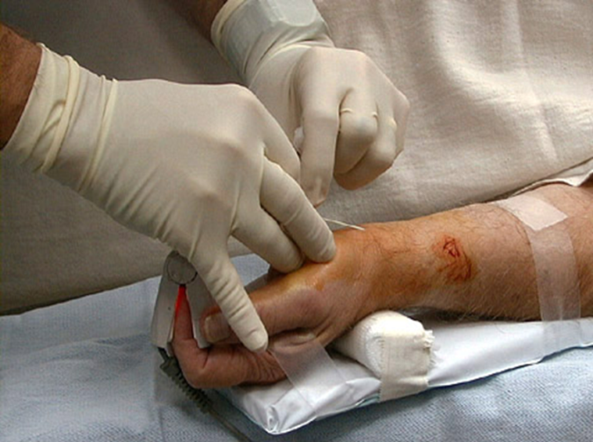
Arterial Pressure
Fadi Jehad Zaben RN MSN
IMET 2000, Ramallah.

Slide 2
Outline:
Overview.
Arterial line system.
Site of line.
Indications.
Uses.
Calibration.
Complications.
Nursing care.

Slide 3
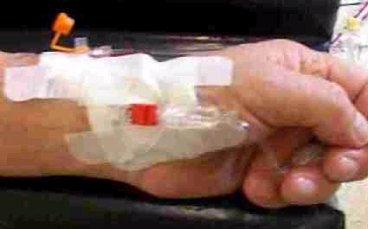
Definition:
An arterial line is a hollow plastic tube (much like an IV catheter). A doctor or special nurse places the line in the patient’s wrist, elbow, or groin.
In newborns it may be placed in the bell button area of the abdomen.
The arterial line is in an artery.

Slide 4
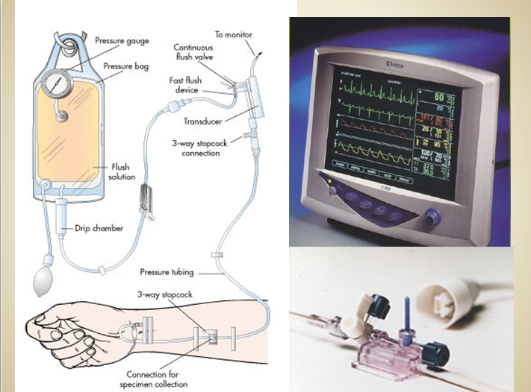

Slide 5
Indications:
Continuous monitoring of arterial blood pressure evaluation.
Tissue perfusion status.
Trends in blood pressure.
Efficacy of drugs, interventions.
Frequent blood samples required.

Slide 6
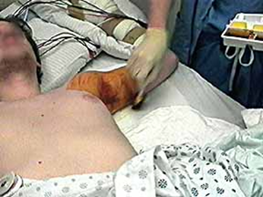
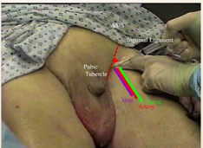
Arterial Lines Site Insertion:
Radial
Brachial
Axillary
Femoral
Dorsalis pedis

Slide 7
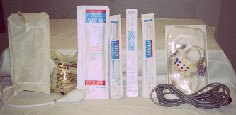
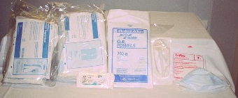
Equipment:
Arterial Catheter.
Pressure Tubing.
Pressure Cable.
Pressure Bag.
Flush – 500cc NS.
Sterile Gown.
Sterile Towels.
Sterile Gloves.
Suture (silk 2.0).
Chlorhexidine Swabs.
Mask.

Slide 8
Monitoring of Arterial Pressure:
Arterial pressure useful for:
sustain hypotension or low blood pressure.
A pressure difficult to measure by the cuff method.
When continuous blood pressure readings are desired, e.g during the administration of hypertension or hypotesnive agent.
When it is desirable to obtain systolic, diastolic and mean Arterial Pressure (MAP).
MAP, Best indicator of tissue perfusion.
Average driving pressure of blood during cardiac cycle.

Slide 9
Leveling and Zeroing:
Leveling:
  Before/after insertion
  If patient, bed or transducer move
Zeroing:
  Performed before insertion & readings
Level and zero at the insertion site.

Slide 10
CALIBRATION
The accuracy of blood pressure measurement requires an accurate reference point that is the patient mid axillary line.
Zeroing process is done by closing the patient side and opening the other end of the three way to the atmosphere.
Now press zero.

Slide 11
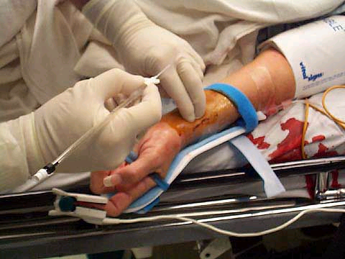

Slide 12
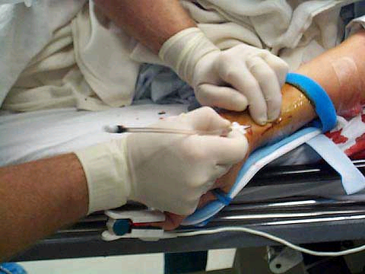

Slide 13
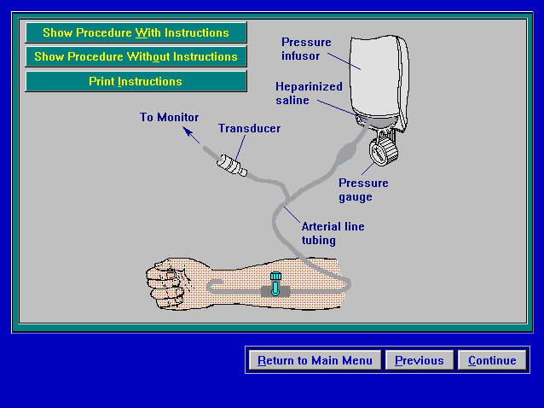

Slide 14
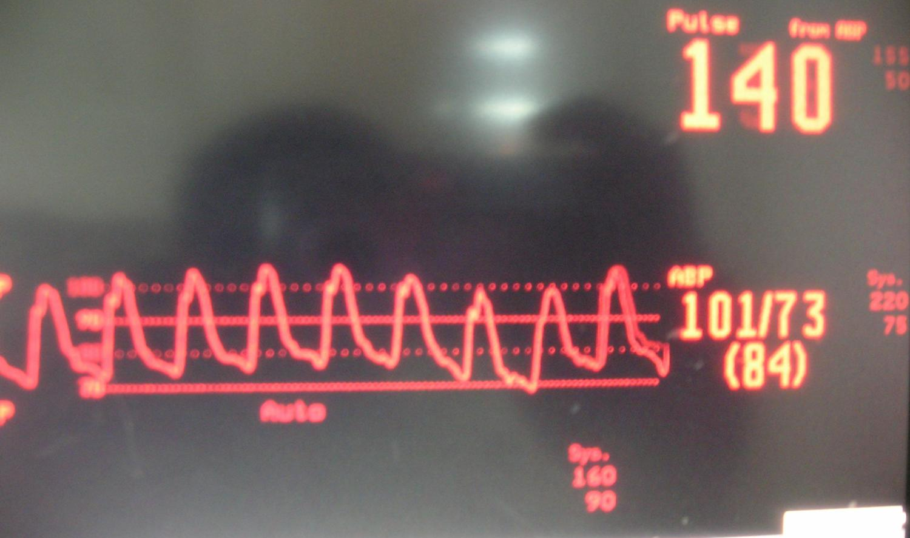
Arterial Blood Pressure

Slide 15
Special Consideration:
Inject no medication:
  Artery very susceptible to spasm and stop blood flow, so inject only with heparinized saline.
  Never force the line: special if the line appears to be clotted, if the clot forced it may travel on down the limbs and cause blockage of circulation
  Check all connections frequently: any disconnection may result in rapid loss of a large amount of blood.
  Check the site of insertion include assessing: color, temp., edema, movement, capillary refill, leaking, discomfort and pulse.

Slide 16
Blood Sampling from Arterial Lines:
ARTERIAL BLOOD GASES (ABG).
OTHER BLOOD SAMPLES.

Slide 17
EQUIPMENT:
5ml syringe.
Universal precautions equipment.
Gauze / Tissue.
Luer lock injection site (“bung”).

Slide 18
PROCEDURE:
1. Before taking blood sample from arterial line, ensure that arterial line is patient, ie the pressure bag is pumped up to 300mmHg, the tubing from the arterial site to the 3-way tap is clear and the line flushes easily.
2. Explain procedure to the patient.
3. Observe universal precautions.
4. Remove “bung” from 3-way tap closest to patient.

Slide 19
5. Insert the 5ml syringe into the 3-way tap, turn the tap OFF to the flush solution and gently withdraw 5mls of blood. Discard this syringe and blood.
6. Turn the 3-way tap OFF half way between the syringe and the transducer line (by doing this, the tap will be closed to all directions).
7. Gently withdrawal blood sample with appropriate syringe.

Slide 20
8. Turn 3-way tap OFF to patient and remove the syringe. Flush the line, using flushing device, making sure line and 3-way stopcock are clear of blood. Insert clean bung into 3-way tap.

Slide 21
Complications:
Hemorrhage.
  Vascular insufficiency.
  Catheter too large.
Thrombus or emboli.
Infection.
Thrombosis.
Hematoma.
Ischemia.

Slide 22
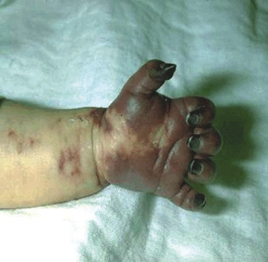
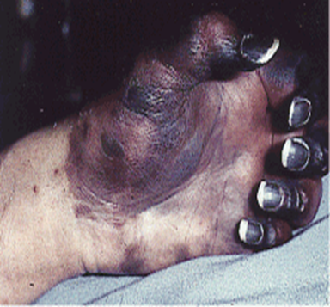

Slide 24
REMOVAL OF ARTERIAL LINE:
This is an aseptic procedure.
Remember universal precautions.
The procedure should be explained to the patient.
Take dressing off line.
Remove arterial line ensuring that the entry site is covered with gauze.
Apply digital pressure for at least 5 minutes to ensure haemostasis.
Dress site with gauze and micropore.
Assess the peripheral circulation as thrombosis can occur after removal.

Slide 25
Nursing Care :
Nursing care mainly directed to preventing complications.
Ensure that the insertion site is visible at all times:
  This may not be possible with femoral-sited arterial lines.
  To ensure early detection of disconnection or leaking from site.
  To maintain patients dignity.

Slide 26
Nursing Care………Continue……
All connections must be secured with luer locks to prevent accidental disconnection.
Ensure that the cannula site is covered with an appropriate dressing to maintain asepsis.
Place a label reading “Arterial line” next to the sampling three-way tap to ensure correct identification of the arterial line.
Never inject anything into an arterial cannula or arterial line.

Slide 27
Nursing Care………Continue……
Ensure that the flush bag has adequate fluid.
Use only 0.9% sodium chloride.
Ensure that the pressure in the pressure bag is maintained at 300mmHg.
Do not allow the flush bag to empty:
  To maintain patency of arterial cannula.
  To prevent air embolism.
  To maintain accuracy of blood pressure reading.
  To maintain accuracy of fluid balance chart.
  To prevent backflow of blood.

Slide 28
Nursing Care………Continue……
Monitor color & temperature of limb distal to arterial line & compare to other limb:
  To confirm that circulation to the limb is adequate.
  To ensure the early detection of impaired circulation.
Monitor and display the arterial waveform at all times to detect cannula disconnection.
Rezero transducer once per shift to ensure accuracy in measuring blood pressure
Explanation to patient and relatives.

Slide 29

Nursing Care………Continue……
Maintain the transducer level with the patient’s phlebostatic axis (fourth intercostal space midaxillary line) to ensure accuracy in measuring blood pressure.
In patients with ICP monitoring it is appropriate to level the transducer to the tagus of the ear.
Change the transducer set only when the cannula is resited to reduce the risk of infection.

Slide 30
QUESTIONS????

