Slide 1
ACUTE PYELONEPHRITIS
Fadi Jehad Zaben RN MSN
IMET 2000, Ramallah

Slide 2
Outline:
Definition
Types
Etiology
Clinical features
Management

Slide 3
Overview:
Acute pyelonephritis is a potentially organ- and/or life-threatening infection that characteristically causes scarring of the kidney.
An episode of acute pyelonephritis may lead to significant renal damage, sepsis and multiorgan system failure.
Diagnosing and managing acute pyelonephritis is not always straightforward.
Wide variation exists in the clinical presentation, severity, options, and disposition of the disease.
The cost of treating acute pyelonephritis has been estimated to be $2.14 billion per year.

Slide 4
Definition:
Bacterial pyelonephritis is an acute infection and inflammatory disease of the kidney and renal pelvis Involving one or both kidneys.
OR
It is Bacterial infection of the renal pelvis, tubules and interstitial tissue of one or both kidneys.

Slide 5
Epidemiology:
Epidemiologic data on the incidence of pyelonephritis are limited.
Acute pyelonephritis in the United States:
15-17 cases per 10,000 females.
3-4 cases per 10,000 males.
At least 250,000 cases of pyelonephritis are diagnosed annually.
Acute pyelonephritis develops in 20-30% of pregnant women with untreated asymptomatic bacteriuria (ABU) (2-9.5%), most often during the late second and early third trimesters.
Pyelonephritis is significantly more common in females than in males, although this difference narrows considerably with increasing age.
Acute pyelonephritis shows a seasonal variation.

Slide 6
Pathophysiology and Etiology:
Enteric bacteria, such as E. coli, is most common pathogen; other gram-negative pathogens include Proteus species, Klebsiella, and Pseudomonas. Gram-positive bacteria are less common, but include Enterococcus and Staphylococcus aureus.
Bacterial infection usually ascends from the lower urinary tract; however, hematogenous migration is possible (particularly with S. aureus).

Slide 7
Continue……
Pyelonephritis can result from urinary obstruction such as vesicoureteral reflux (incompetence of ureterovesical valve, which allows urine to regurgitate into ureters, usually at time of voiding), other renal disease, trauma, or pregnancy.
Low-grade inflammation with interstitial infiltrations of inflammatory cells may lead to tubular destruction and abscess formation.
Chronic pyelonephritis may result in scarred, atrophic, and nonfunctioning kidneys.

Slide 8
Bacterial Etiology of Urinary Tract Infections
Bacteria | % Uncomplicated | % Complicated
Gram negative
Escherichia coli | 70-95 | 21-54
Proteus mirabilis | 1-2 | 1-10
Klebsiella spp | 1-2 | 2-17
Citrobacter spp | < 1 | 5
Enterobacter spp | < 1 | 2-10
Pseudomonas aeruginosa | < 1 | 2-19
Other | < 1 | 6-20
Gram positive
Coagulase-negative staphylococci | 5-10* | 1-4
Enterococci | 1-2 | 1-23
Group B streptococci | < 1 | 1-4
Staphylococcus aureus | < 1 | 1-23
Other | < 1 | 2
Adapted from Hooton TM. The current management strategies for community-acquired urinary tract infection. Infect Dis Clin North Am. Jun 2003;17(2):303-32. [Medline].

Slide 9
Types:
Acute Pyelonephritis.
Chronic Pyelonephritis.

Slide 10
Pathology:
Kidneys enlarge
Interstitial infiltration of inflammatory cells
Abscesses on the capsule and at corticomedullary junction
Result in destruction of tubules and the glomeruli.

Slide 11
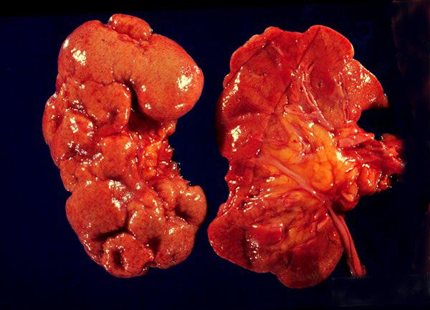
Scarred and contorted kidneys

Slide 12
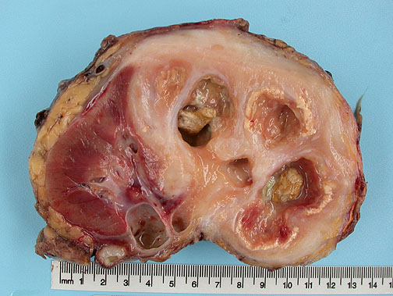
Destruction of approximately 70% of the kidney. Numerous dilated calyces with yellow-brown calculi. The central necrotic areas are surrounded by dense fibrosis.

Slide 13
Signs and Symptoms:
Fever.
Chills.
Flank pain (with or without radiation to groin).
Nausea, vomiting, and anorexia.
Renal angle tenderness.
Leukocytosis
Pyuria
Bacteriuria
Urgency, frequency, and dysuria may be present.

Slide 14
Diagnosis:
Urinalysis (dipstick or microscopic) to identify leukocytes, bacteria, and RBCs and WBCs in urine; white cell casts may also be seen.
Urine culture to identify causative bacteria.
CBC shows elevated WBC count consisting of neutrophils and bands.
Intravenous urography (IVU) or renal ultrasound to evaluate for urinary tract obstruction; other radiologic or urinary tests as necessary.

Slide 15
Management:
For severe infections (dehydrated, cannot tolerate oral intake) or complicating factors (suspected obstruction, pregnancy, advanced age), inpatient antibiotic therapy is recommended.
Usually immediate treatment is started with a penicillin or aminoglycoside I.V. to cover the prevalent gram-negative pathogens; subsequently adjusted according to culture results.
An oral antibiotic may be started 24 hours after fever has resolved and oral therapy continued for 3 weeks.

Slide 16
Continue……
Oral therapy antibiotic therapy is acceptable for outpatient treatment.
Co-trimoxazole (Bactrim, Septra) or a fluoroquinolone is used; 10 to 14 days is the usual length of treatment.
Repeat urine cultures should be performed after the completion of therapy.
Supportive therapy is given for fever and pain control and hydration.

Slide 17
First-line therapy
ciprofloxacin (Cipro) 500 mg PO BID for 7d or ciprofloxacin extended-release (Cipro XR) 1000 mg PO daily for 7d or levofloxacin (Levaquin) 750 mg PO daily for 5d If fluoroquinolone resistance is thought to be >10%, administer a single dose of ceftriaxone (Rocephin) 1g IV or a consolidated 24-hour dose of an aminoglycoside (gentamicin 7 mg/kg IV or tobramycin 7 mg/kg IV or amikacin 20 mg/kg IV)
Second-line therapy
trimethoprim/sulfamethoxazole* 160 mg/800 mg (Bactrim DS, Septra DS) 1 tablet PO BID for 14d If trimethoprim/sulfamethoxazole is used when the susceptibility is not known, an initial single IV dose of the following may also be given: ceftriaxone (Rocephin) 1 g IV or a consolidated 24-h dose of an aminoglycoside (gentamicin 7 mg/kg IV or tobramycin 7 mg/kg IV or amikacin 20 mg/kg IV)
Alternative therapy
Oral beta-lactams are not as effective for treating pyelonephritis; however, if they are used, administer with a single dose of ceftriaxone (Rocephin) 1 g IV or a consolidated 24-h dose of an aminoglycoside (gentamicin 7 mg/kg IV or tobramycin 7 mg/kg IV or amikacin 20 mg/kg IV) amoxicillin-clavulanate (Augmentin) 500 mg/125 mg PO BID for 14d or amoxicillin-clavulanate (Augmentin) 250 mg/125 mg PO TID for 3-7d or cefaclor 500 mg PO TID for 7d *Should generally be avoided in elderly patients because of the risk of affecting renal function.

Slide 18
Complications:
Bacteremia with sepsis.
Papillary necrosis leading to renal failure.
Renal abscess requiring treatment by percutaneous drainage or prolonged antibiotic therapy.
Perinephric abscess.
Paralytic ileus.

Slide 19
Nursing Diagnoses:
Hyperthermia due to infection.
Acute Pain related to renal swelling and edema.

Slide 20
Reducing Body Temperature
Administer or teach self-administration of antibiotics as prescribed, and monitor for effectiveness and adverse effects.
Assess vital signs frequently, and monitor intake and output; administer antiemetic medications to control nausea and vomiting.
Administer antipyretic medications as prescribed and according to temperature.

Slide 21
Continue…….
Report fever that persists beyond 72 hours after initiating antibiotic therapy; further testing for complicating factors will be ordered.
Use measures to decrease body temperature if indicated; cooling blanket, application of ice to armpits and groins, and so forth.
Correct dehydration by replacing fluids, orally if possible, or I.V.
Monitor CBC, blood cultures, and urine studies for resolving infection.

Slide 22
Relieving Pain
Administer or teach self-administration of analgesics, and monitor their effectiveness.
Use comfort measures, such as positioning, to locally relieve flank pain.
Assess patient's response to pain control measures.

Slide 23
THE END

